Slide 1


Gitlab Process
DevOps Easy Learning

Slide 2
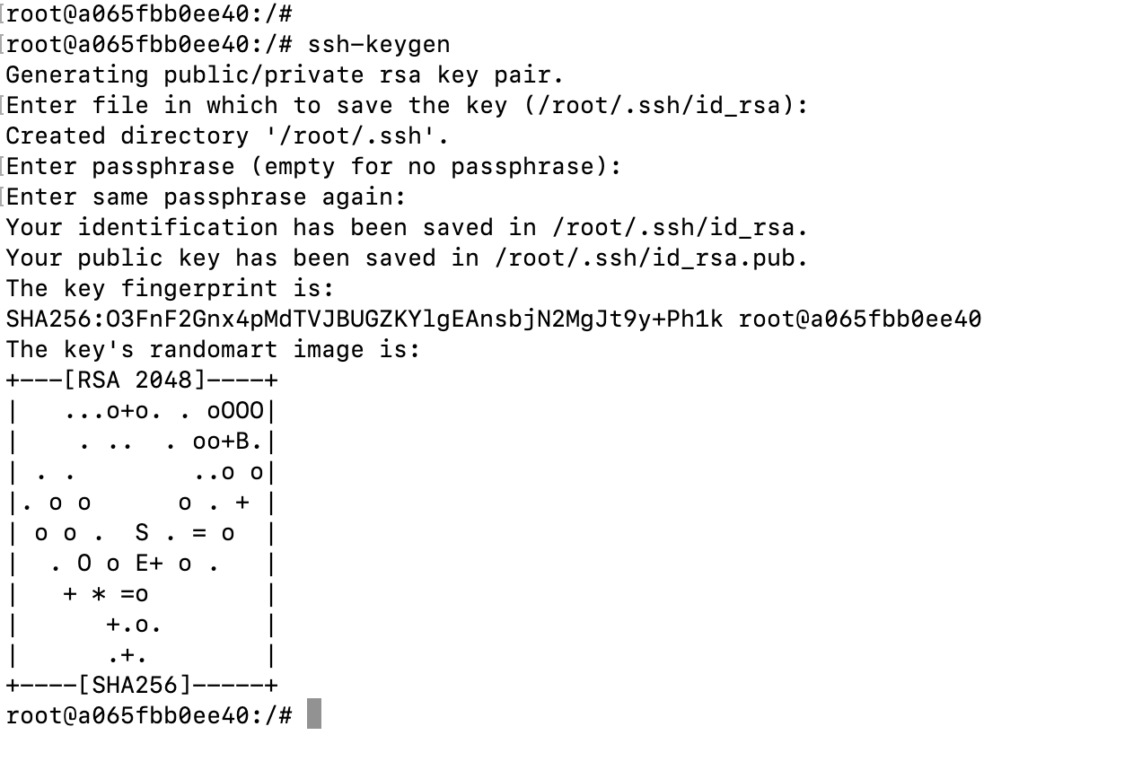
Generate ssh-key
1
enter this command
2
Just press enter on your keyboard
3
Just press enter on your keyboard
4
Just press enter on your keyboard
here is your ssh-key public location by default it is located at ~/.ssh/id_rsa.pub
5

Slide 3
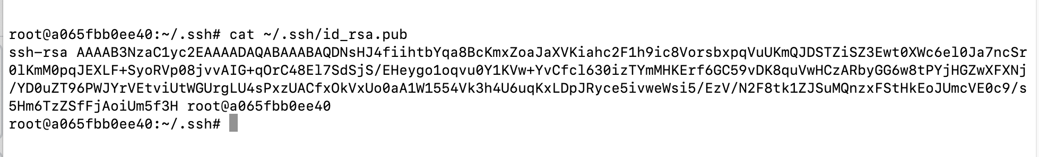
View and copy ssh-key
1
enter this command
2
copy your public key ( the entire key)
you will need this on gitlab.

Slide 4
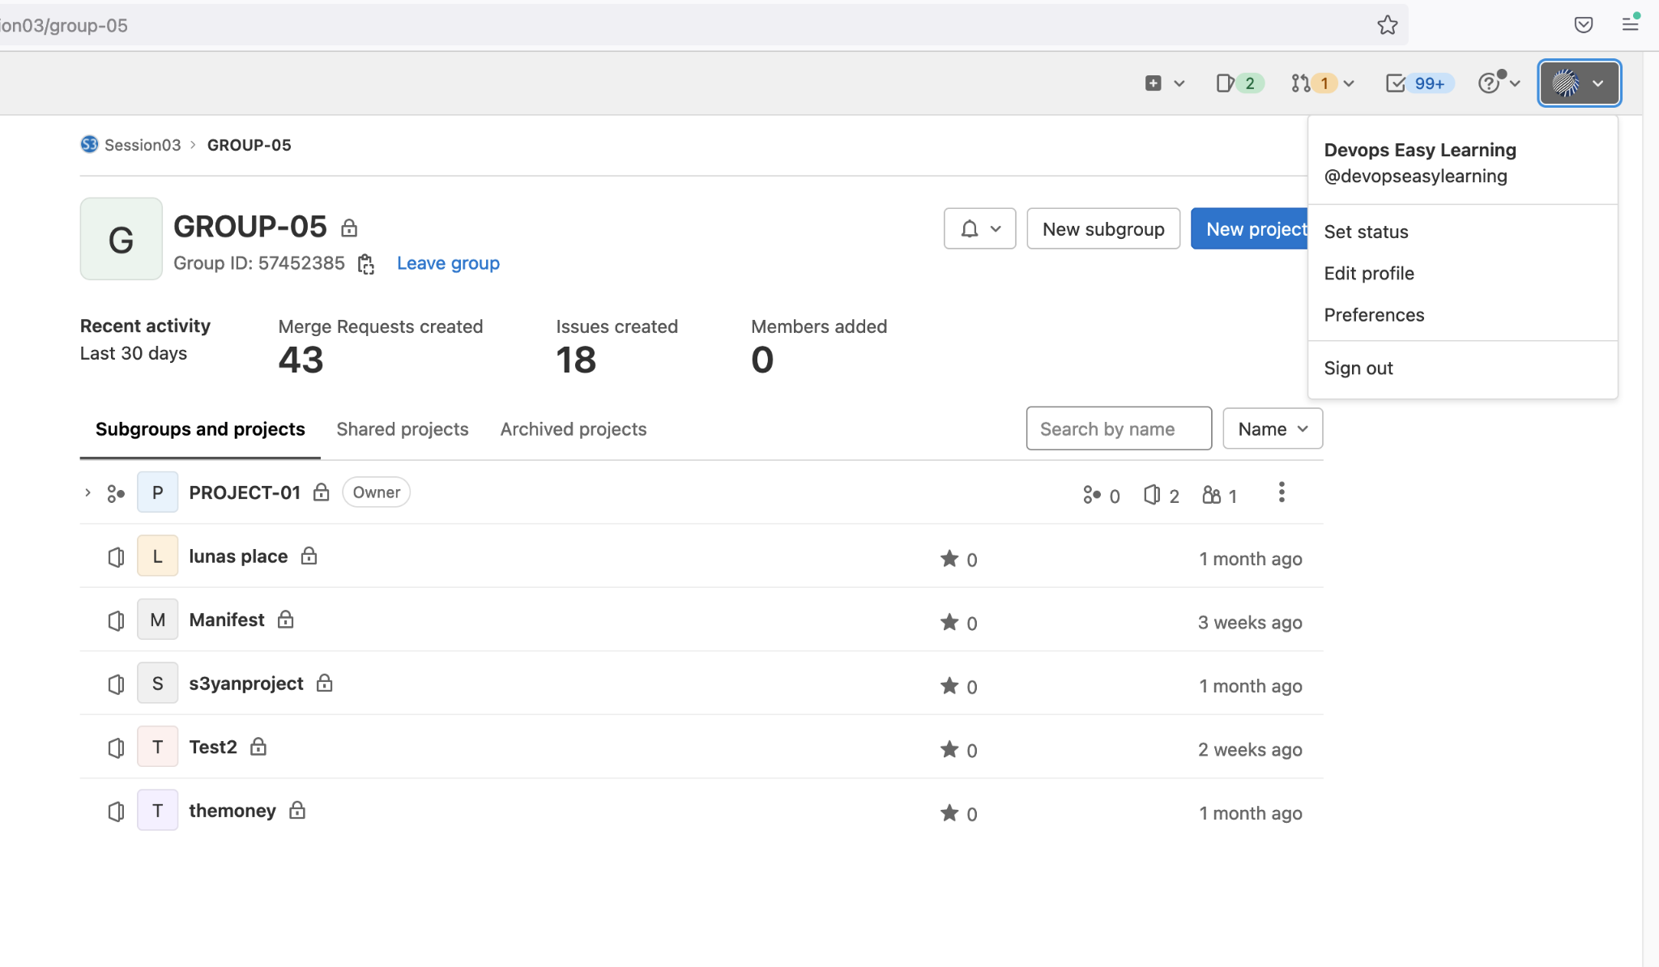
Adding your key to Gitlab
1
click here
2
then click here

Slide 5
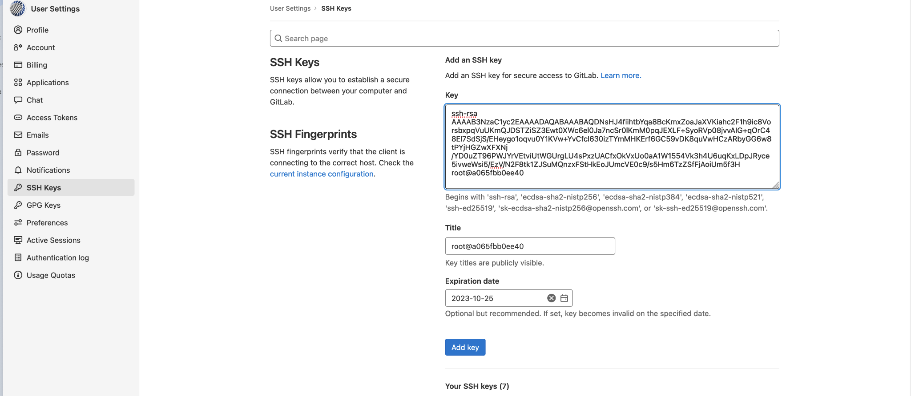
Adding your key to Gitlab
1
2
enter key here
3
Optional
4
set a date
5

Slide 6
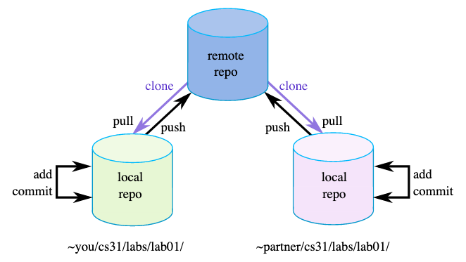
git

Slide 7
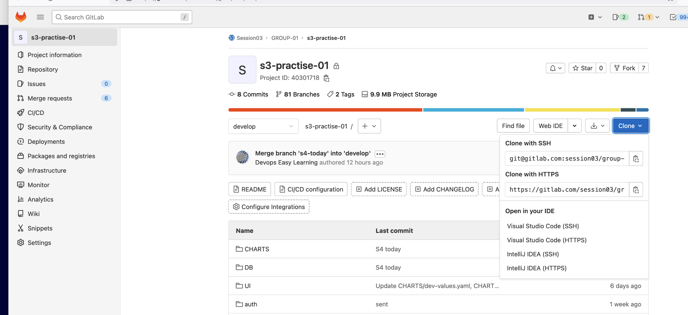
Cloning from Gitlab (ssh)
1
make sure to be on a project
2
Click here
3
3
Copy ssh link
when you clone ssh you can update the code and commit it back to gitlab

Slide 8
Cloning from Gitlab (ssh)
1
make sure to be on a project
2
Click here
3
3
Copy https link
when you clone https you can update the code but will NOT be able to commit it back to gitlab

Slide 9
Create a new branch and make change
1
2
3
4
git clone [repo url]
cd into the repo
git pull - - all
git checkout –b [ new branch name]
5
git branch
to make sure you are on a correct branch
12
11
10
8
6
git push --set-upstream origin [the branch you are working on ]
Git commit –m “[commit message]”
git config --global user.name "[your user name on gitlab]”
git config --global user.email [your email address on gitlab]
git add -A
Make required modifications
13
7
Go on gitlab and raise a pull request
9
git status
To see all changes
Git status
To see all to be committed

Slide 10
Create a new branch and make change: EXAMPLE
$ ssh [prefere_name]@server1.anomicatech.com ----------------- here you login to one of our server
$ mkdir GIT-WORKS
$ cd GIT-WORKS
$ git clone git@gitlab.com:session03/group-01/s3-practise-01.git
$ cd s3-practise-01
$ git pull - -all
$ git branch --------------- checking the branch you are in now
$ git checkout –b eric-learning-git --------------- creating new branch and switching to that branch
$ git branch --------------- checking the branch you are in now, not that your current branch has change
$ echo “devops is sweet” >> eric-money.txt ------------make any change or required change
$ echo “devops is good” >> eric-money.txt ------------make any change or required change
$ git status ------------ to see the change you make will appear in red color
$git add –A or git add . --------------- both will work the same
$ git config --global user.name "[your gitlab username]”
$ git config --global user.email [your gitlab email]
$ git status ------------ to see the change you make will appear in green color
$ git commit –m “[commit message]” --------------- add a commit message best practice describe what you did
$ git push --set-upstream origin eric-learning-git ------------ to push to github

Slide 11
Make change on an existing branch
5
1
2
3
4
git pull - -all
git clone [repo url]
cd into the repo
git branch –a
git checkout [ new branch name]
11
10
12
when you run this once it stays forever
8
6
git push
Git commit –m “[commit message]”
git config --global user.name "[your user name on github]”
git config --global user.email [your email address on github]
Git add -A
Make required modifications
13
Go on gitlab and raise a pull request
9
7
Git status
To see all to be committed
Git status
To see all change

Slide 12
Make change on an existing branch : EXAMPLE
$ ssh [prefere_name]@server1.anomicatech.com ----------------- here you login to one of our server
$ mkdir GIT-WORKS
$ cd GIT-WORKS
$ git clone git@gitlab.com:session03/group-01/s3-practise-01.git
$ cd s3-practise-01
$ git pull - -all
$ git branch –a --------------- to see all branches and select you branch
$ git checkout eric-learning-git --------------- switching to that branch, the branch exist already
$ git branch --------------- checking the branch you are in now, not that your current branch has change
$ echo “devops is sweet” >> eric-money.txt ------------make any change or required change
$ echo “devops is good” >> eric-money.txt ------------make any change or required change
$ git status ------------ to see the change you make will appear in red color
$git add –A or git add . --------------- both will work the same
$ git config --global user.name "[your gitlab username]”
$ git config --global user.email [your gitlab email]
$ git status ------------ to see the change you make will appear in green color
$ git commit –m “[commit message]” --------------- add a commit message best practice describe what you did
$ git push --set-upstream origin eric-learning-git ------------ to push to github

Slide 13
Update a Pull Request or a branch
1
2
3
4
5
git pull - -all
Make required modifications
git status
To see all change
git add -A
git status
To see all to be committed
6
9
8
7
git config --global user.name "[your user name on github]”
git config --global user.email [your email address on github]
Go on gitlab and raise a pull request
git push
git commit –m “[commit message]”

Slide 14
Update a Pull Request or a branch: example
$ git pull –all
$ echo “devops is sweet” >> eric-money.txt ------------make any change or required change
$ echo “devops is good” >> eric-money.txt ------------make any change or required change
$ git status ------------ to see the change you make will appear in red color
$git add –A or git add . --------------- both will work the same
$ git status ------------ to see the change you make will appear in green color
$ git commit –m “create eric-money.txt” --------------- add a commit message best practice describe what you did
$ git push ------------ to push to github

Slide 15
Branching Strategy at EK TECH SOFTWARE SOLUTION

Slide 16


PROTECTED BRANCHES
develop
production
No commit allow, branch should only be updated by Merge Request with at least two approval.

Slide 17
PROTECTED BRANCHES
develop
production
No commit allow, branch should only be updated by Merge Request with at least two approval.

Slide 18
Flow
1
2
3
developer get create a branch from develop
developer update the code on his branch and commit to gitlab
a pipeline in triggered but developer change and the developer branch goes through the pipeline
4
5
developer raise a Merge Request and assign reviewer
pipeline pass
pipeline fail
developer branch is merge on develop
6
pipeline pass
pipeline fail
the application is deploy automatically
developer will keep updating his branch until it passes
deployment pass
deployment fail
7
8
code is merge to production
code is tag
development team notify testing team
9

Slide 19
Branching Strategy
develop --------- protected
master -------- protected
no one can commit into the master or develop branch without pull request
all pull requests into the develop or master branch will required
1- two approvals
2- pipeline to succeed
3- all issue to be resolved
the master branch can only be modified by a pull request from the develop branch ONLY
all application tag can only be made fro the master branch

